Slide 1
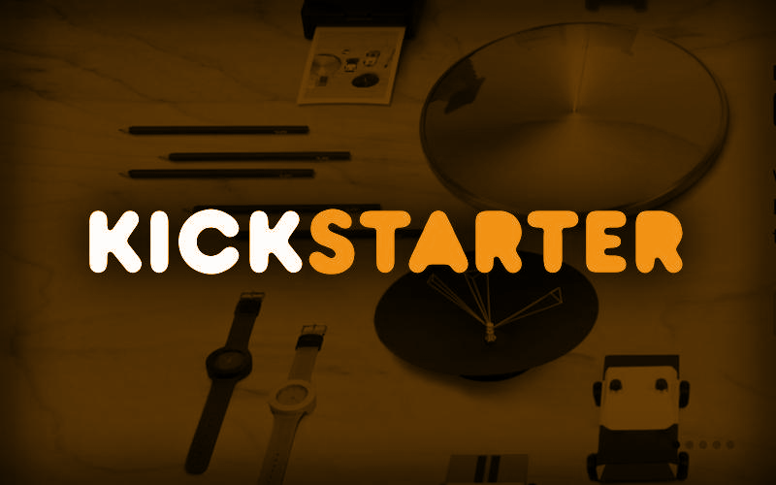
Heena Bhatia

Slide 2
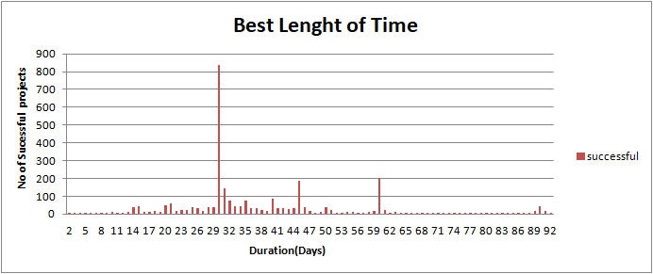
What is the best campaign duration?
On average the best campaign duration of successful projects is 30 days.

Slide 3
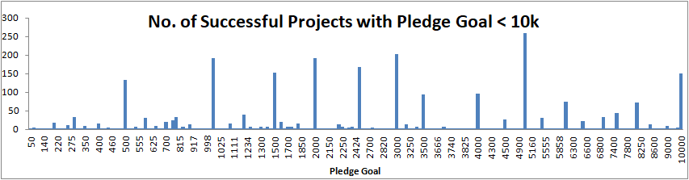
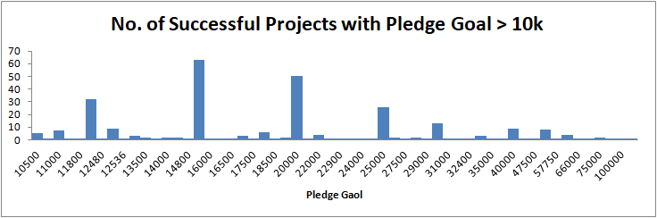
What is the ideal pledge goal?
On average more number of successful projects has pledge goal < 10k.
Highest number of successful projects has pledge goal around 5k.
Less number of successful projects with pledge goal > 10k.

Slide 4
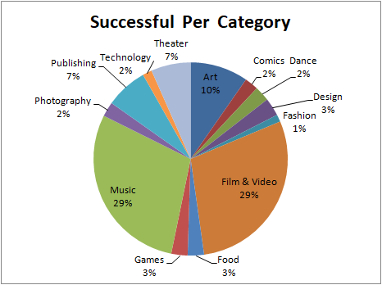
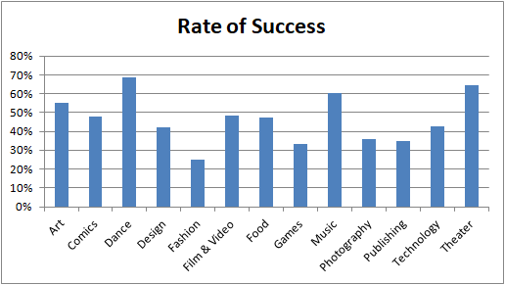
Successful Projects Category
Film & video and Music has highest number of successful projects.
Dance category has the highest rate of success followed by Theater and Music.

Slide 5
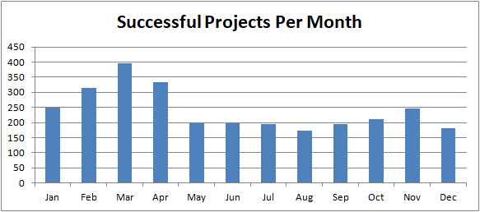
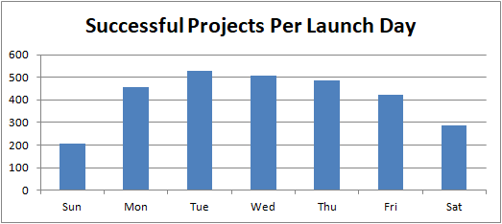
Ideal time to launch Campaign
Month: Campaign for most successful projects was launched in March.
Day: Most of successful projects were launched on Tuesday.

